Slide 1

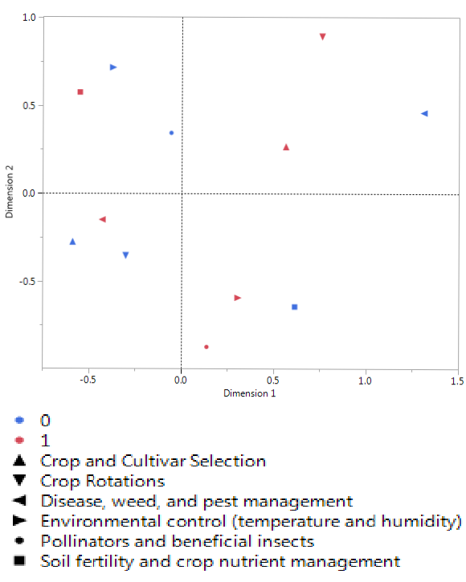




Growing High Tunnel Use for Organic Vegetable Production in the Southeast
Kaylene Sattanno¹, M. E. Swisher¹, James Colee², Xin Zhao³, Zhifeng Gao⁴, and Zachary Black³
¹Family, Youth & Community Sciences Dept., ²Statistics Dept., ³Horticultural Sciences Dept., and ⁴Food & Resource Economics Dept.
I N T R O D U C T I O N
Stakeholder-driven organic high tunnel systems research in the Southeast is lagging behind what has been investigated for cooler climates. Organic vegetable growers in humid sub-tropical climates will benefit from research evaluating how to optimize these protected culture systems in a way that integrates improved crop performance and resilience, environmental stewardship, and economic viability.
M E T H O D S
We completed in-depth interviews with eight organic producers with experience using high tunnels. We identified major research needs expressed by an expert panel and sent them a short follow-up questionnaire to ensure we reached valid conclusions. The expert panel ranked the six broad research topics in order of importance and selected the three most important crops to research. Finally, we developed an extensive questionnaire that asked respondents to identify the three most important areas of research and three most important crops to study in future projects.
R E S U L T S
Major research needs expressed by panel:
C O N C L U S I O N S
The objective of the project was to identify critical research needs for developing integrated high tunnel systems to promote the growth and expansion of organic vegetable production in the Southeast. These findings will direct our research objectives in future high tunnel projects focusing on improving organic vegetable production and management.
Crop selection, cover crops, and crop rotations
Using ventilation and heating to manage the high tunnel environment
Soil fertility and nutrient management
Pest and disease management
Economics
Attracting pollinators and beneficial insects
Follow-up questionnaire conclusions:
Table 2: Ranking of most profitable crops.
1. The panel is concerned with:
Most Profitable Crops | Ranking
Salad greens | 1
Tomatoes | 2
Cucumbers | 3
pest and disease management,
crop rotations, crop selection, and cover crops, and
soil fertility management.
2. The panel is interested in researching:
peppers,
salad greens, and
tomatoes.
Florida Organic Growers and Georgia Organics helped distribute the extensive questionnaire to organic high tunnel users in Florida and Georgia. In total, 53 farmers completed our questionnaire – 23 currently use at least one high tunnel for vegetable production, 11 currently use at least one high tunnel for seedling production, and 19 do not currently use a high tunnel.
Table 1: Research area groups based on respondents’ selection frequency.
Grouping | Research Area | Selection Frequency
High Frequency | Disease, weed, and pest management | 40
Moderate Frequency | Environmental control | 29
 | Soil fertility and crop nutrient management | 28
 | Crop and cultivar selection | 27
Low Frequency | Crop rotations | 15
 | Pollinators and beneficial insects | 15
We organized the research priority areas into three groups based on the respondents’ selection frequency (Table 1). We then identified the top three profitable crops that the current high tunnel users produce (Table 2). Figure 1 is the result of multiple correspondence analysis looking at the relationships between those respondents that answered yes (1) or no (0) to the six research areas they show interest in.
0
1
Crop and cultivar selection Crop rotations
Disease, weed, and pest management Environmental control (temperature and humidity) Pollinators and beneficial insects
Soil fertility and crop nutrient management
Figure 1: Multiple correspondence analysis. The closer two points are to each other the more respondents answered them
similarly. The size of the symbols is proportional to the number of respondents who answered that way.
ACKNOWLEDGEMENTS
This work is supported by OREI, Grant no. 2016-51300-25738 from the USDA National Institute of Food and Agriculture.
(Modified for Accessibility by Hunter Gair)

